Slide 1
Online Cryptocurrency Tracker Using Blockchain Technology
Presentation by - Supervisors -
Nitin Srivastava(1805213034) Prof. Girish Chandra
Rajat Agarwal (1805213042) Mr. Deepanshu Singh Yadav
Mayank Maurya(1805213029)
(Group Number- 14)

Slide 2
Introduction
With the increasing popularity of online transaction in Indian Monetary System, the possibility of online frauds with less aware people has become a common news. As a solution to it, cryptocurrencies have emerged as more secure and reliable source of online transaction as well as a valuable asset of investment too.
The fact that they are very secured because of the blockchain technology they use, the chances of online frauds and theft hacking are negligible. For a person to have safe investment or transaction in crypto world, it is always better to have knowledge of the recent trends of the crypto market, the top performing cryptocurrencies in the form of charts and ranks and the daily news updates from crypto market.

Slide 3
Our highly secure online cryptocurrency tracker aims to provide these necessary insights of the crypto world to the common masses in simple, easily accessible and understandable manner so that they do not have the need to go for any other place for the trends. As these markets are totally sentiment based, getting the verified trends, news and possibilities is very crucial in order to be on a safe side.
If a person has to go to multiple sites for the updates, the chances of encountering a fake news related to crypto market is highly possible. So, we aim to solve this problem with the help of our online cryptocurrency tracker which will be single go to place for the trends, top cryptocurrencies and new related to the market.

Slide 4
Objective-
To built an online application on Web 3.0 and implementing Blockchain Technology for safe and secure cryptocurrency exchange between two users. Additionally application also provides authentic and verified data related to crypto-news, current prices of cryptocurrencies, last transactions, etc.

Slide 5
Motivation-
As the digital transaction as a whole concept is pretty new in India and majorly prominent in urban areas, the lack of awareness is the sole reason for the crimes that happen very often in online transaction world. This also contributes in people refraining from switching to online transaction mode. Since the online transaction is new and crypto world is a solution to it, there is a need of a platform which makes people aware and satisfies all the needs for crypto at one place. Because depending on multiple sources for different things increases the chances of getting into scam.
So we identified this gap as our problem statement and focused to tackle this issue with the help of our software solution. We aimed to create a platform where users can do transactions with cryptocurrencies and track all the currencies as well as stay updated and aware about the crypto world in order to prevent online frauds. This was the sole motivation behind working on “Crypto Nite” which is a single go to place for all crypto needs

Slide 6
Methodology
Some of the features of the web application that we have developed will be as follows : -
1. It is a website named “Crypto Nite” which will be a single go to place for all the cryptocurrency requirements.
2. It has an onboarding module which has login and signup functionalities. Users can login and signup using email and password and also, they can login using google login which is very handy and secure
3. It has a landing dashboard which user encounters after login. It comprises of a navigation header which allows user to choose between different sections of the web application.
4. This dashboard consists of 4 modules. The first one is Market Module where user can see the list of all the cryptocurrencies present in the market and their overview details.
5. Users can also see the detailed report of a currency including performance chart by clicking them.

Slide 7
Methodology
6. The second module is Exchange module where users can connect their metamask wallet and make transactions using ETHEREUM cryptocurrency.
7. The transaction details get automatically stored on blockchain forever.
8. The third module is News Module in which the user can see the list of recent news related to crypto world and can read the articles by clicking on them.
9. The 4th and the last module are the logout module which allows user to logout from the app if they don’t want to use it for a while.

Slide 8
What is Blockchain Technology ?
Blockchain technology is a structure that stores transactional records, also known as the block, of the public in several databases, known as the “chain,” in a network connected through peer-to-peer nodes. Typically, this storage is referred to as a ‘digital ledger.’
Every transaction in this ledger is authorized by the digital signature of the owner, which authenticates the transaction and safeguards it from tampering. Hence, the information the digital ledger contains is highly secure.
In simpler words, the digital ledger is like a Google spreadsheet shared among numerous computers in a network, in which, the transactional records are stored based on actual purchases. The fascinating angle is that anybody can see the data, but they can’t corrupt it.

Slide 9
Why Blockchain Technology ?
Suppose you are transferring money to your family or friends from your bank account. You would log in to online banking and transfer the amount to the other person using their account number. When the transaction is done, your bank updates the transaction records. It seems simple enough, right? There is a potential issue which most of us neglect.
These types of transactions can be tampered with very quickly. People who are familiar with this truth are often wary of using these types of transactions, hence the evolution of third-party payment applications in recent years. But this vulnerability is essentially why Blockchain technology was created.
Record keeping of data and transactions are a crucial part of the business. Often, this information is handled in house or passed through a third party like brokers, bankers, or lawyers increasing time, cost, or both on the business. Fortunately, Blockchain avoids this long process and facilitates the faster movement of the transaction, thereby saving both time and money.
Most people assume Blockchain and Bitcoin can be used interchangeably, but in reality, that’s not the case. Blockchain is the technology capable of supporting various applications related to multiple industries like finance, supply chain, manufacturing, etc., but Bitcoin is a currency that relies on Blockchain technology to be secure.

Slide 10
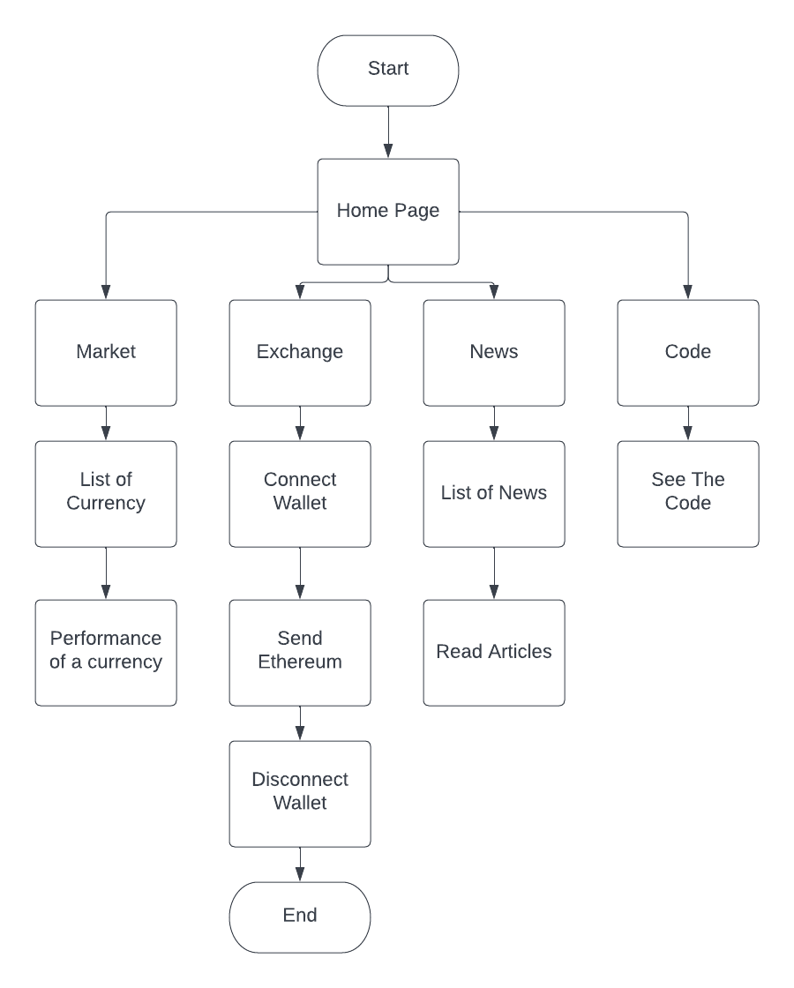
Data Flow diagram of our application-

Slide 11
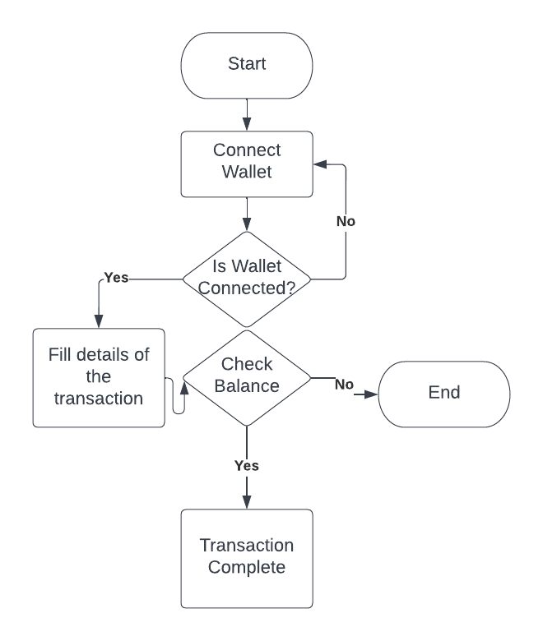
Data Flow diagram for transactional Model and onboarding module-

Slide 12
Technologies Used-
● Backend- Firebase
● GUI Frontend- HTML/CSS, Bootstrap, JavaScript, React.Js, Web3.0, Solidity
● IDE- Visual Studio Code
● Database- Firebase Realtime Database and Blockchain
● API Usage- Google Auth Rest API, Coinranking API and Bing News Search API
● Version Control System- Git Bash, GitHub
● Deployment- Heroku
● Other tools- Jest, Postman, Joi Current Login UI

Slide 13
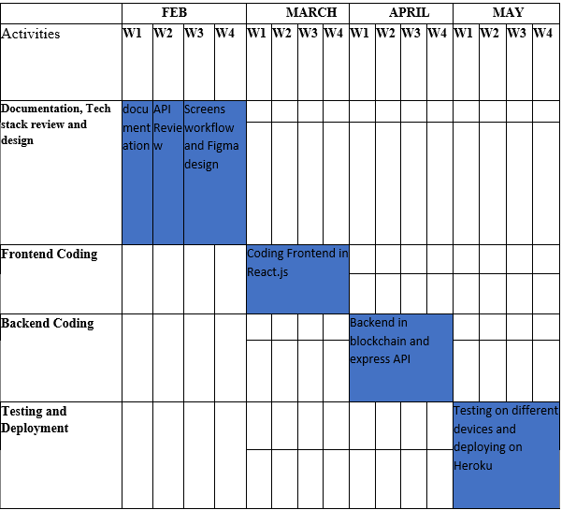
Plan of Action Time chart-

Slide 14
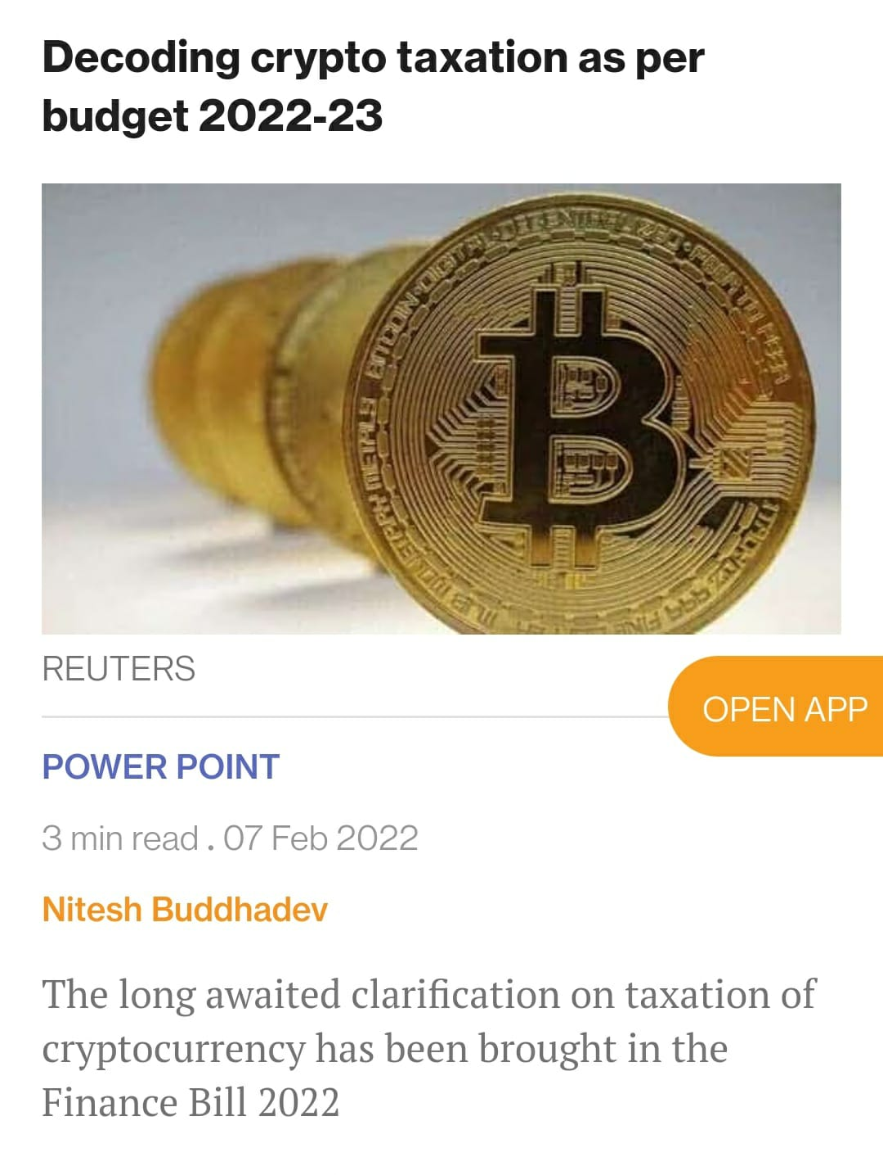
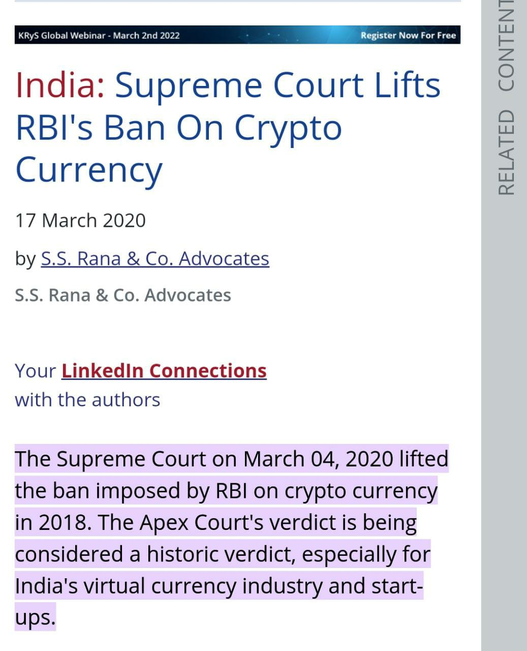
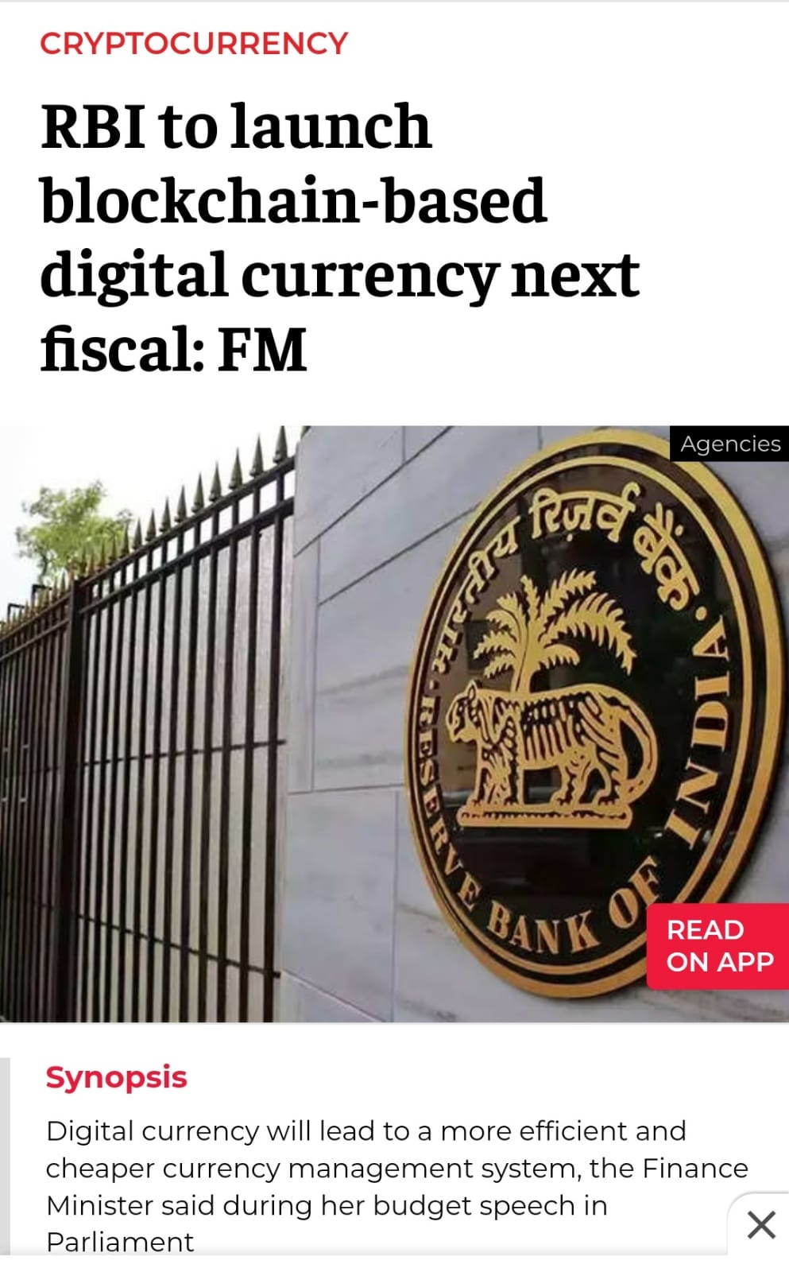
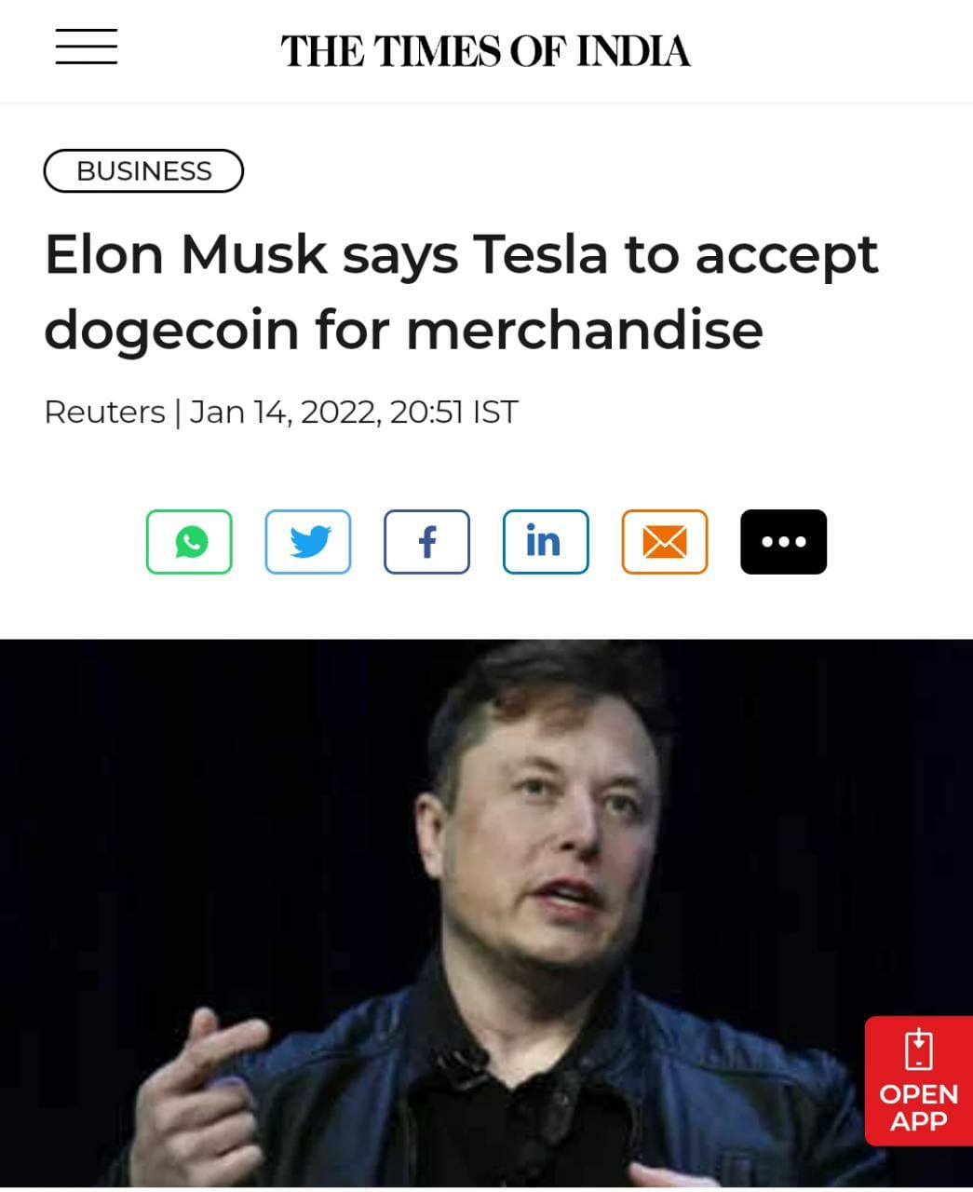
Future Scope- News articles for more reference-
.

Slide 15
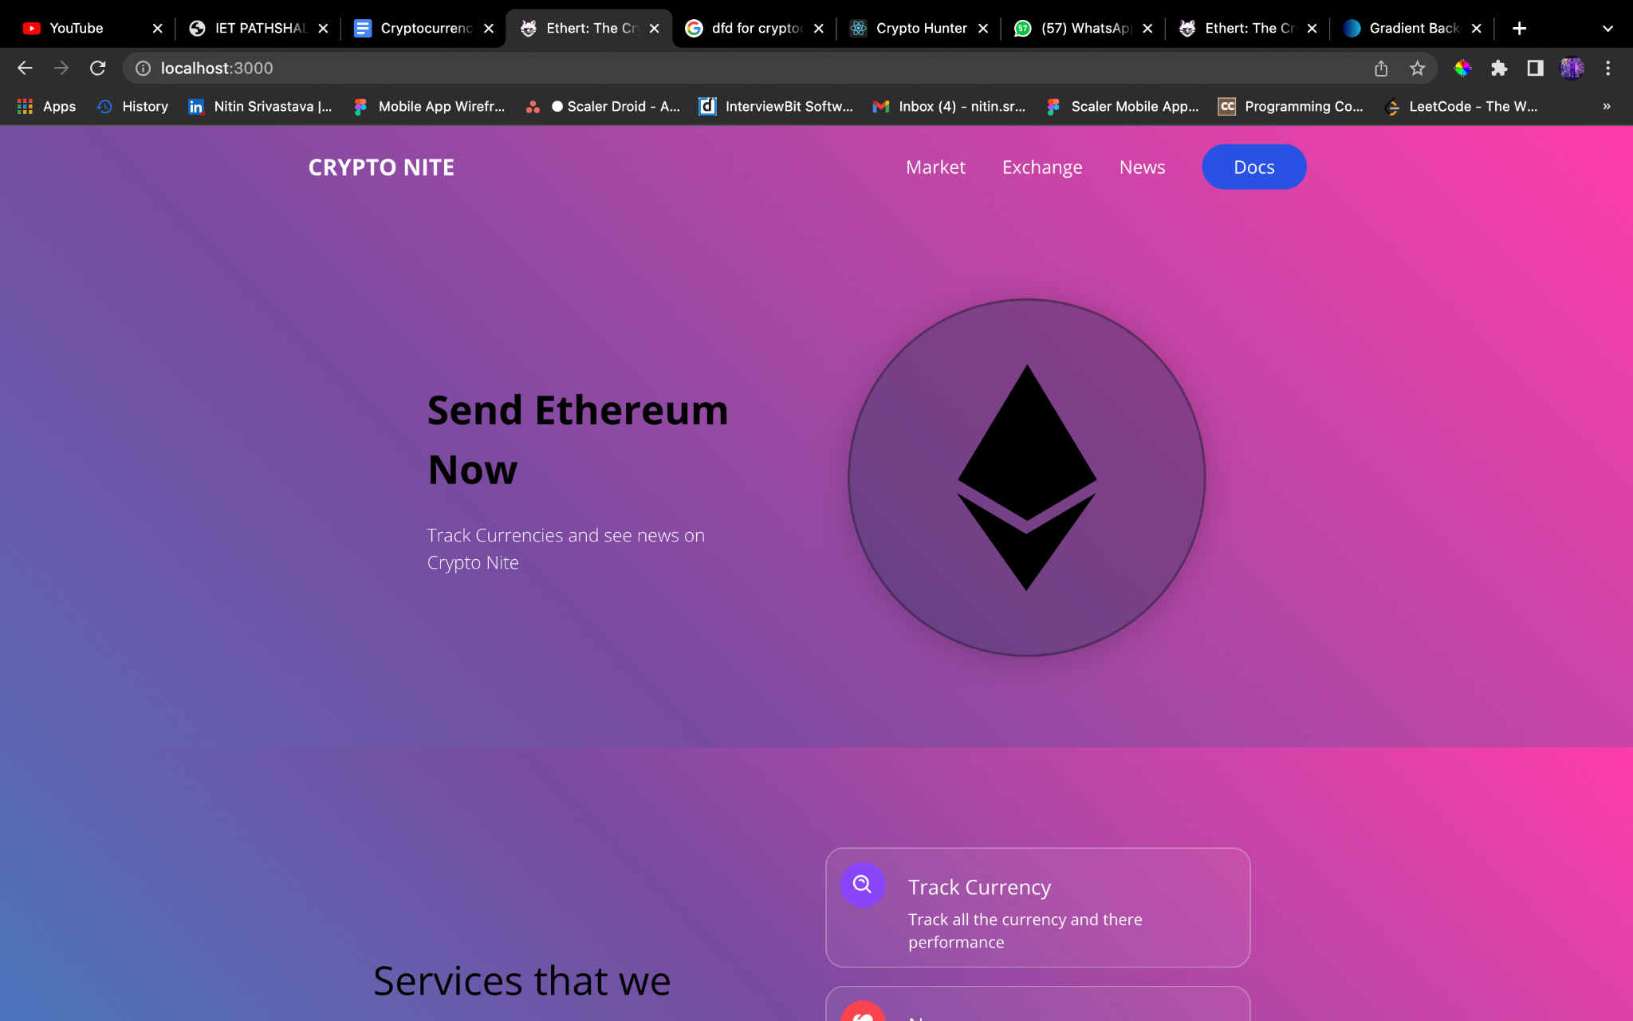
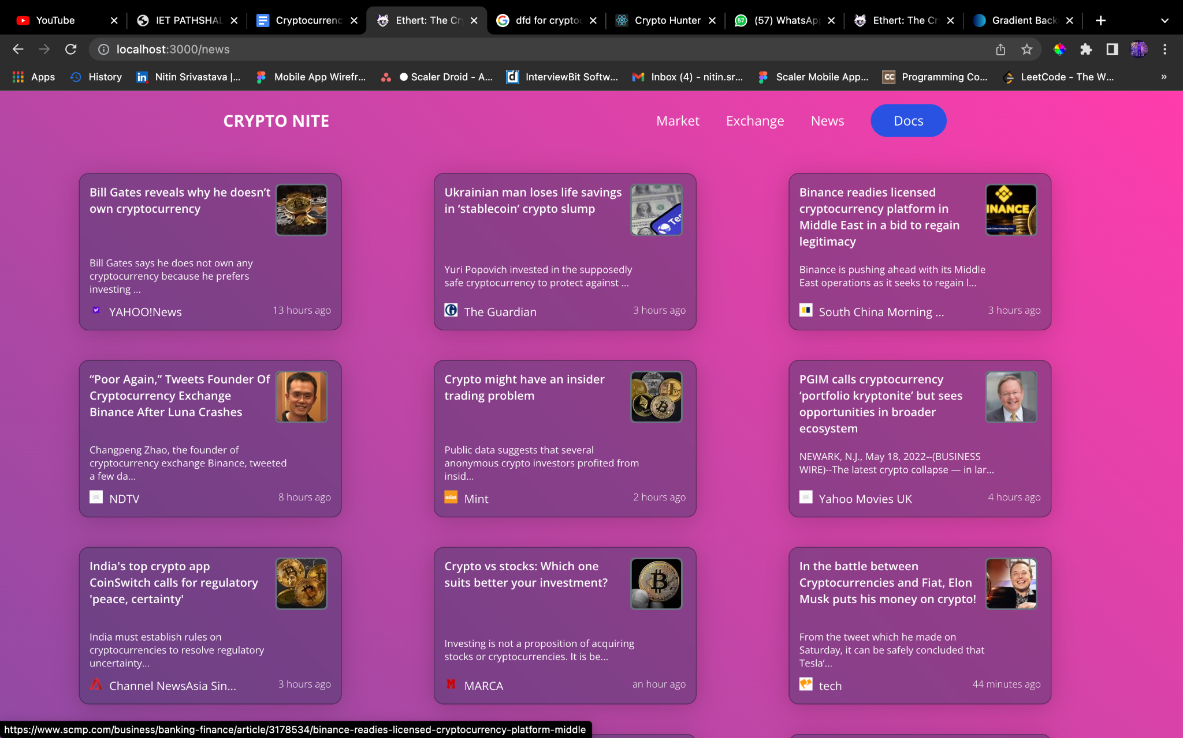
Some Snapshots of project-
Dashboard
News Section

Slide 16
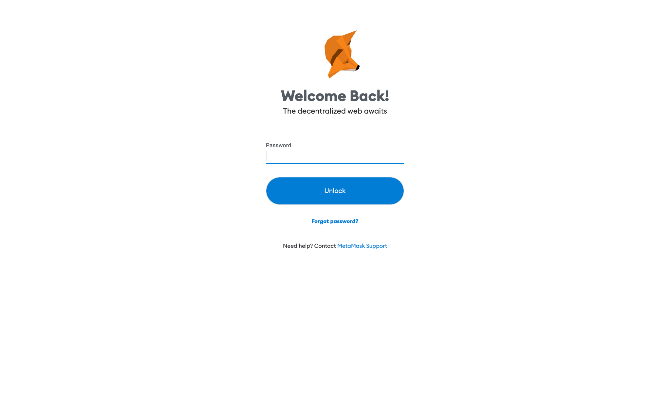
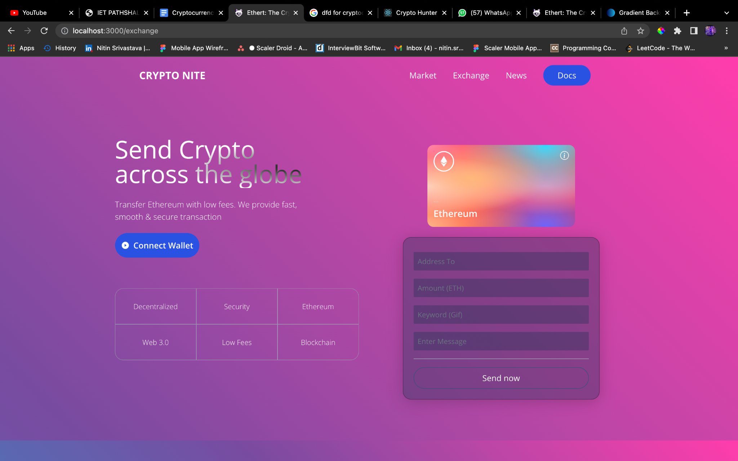
Some Snapshots of project-
Creating Transaction
Metamask Wallet

Slide 17
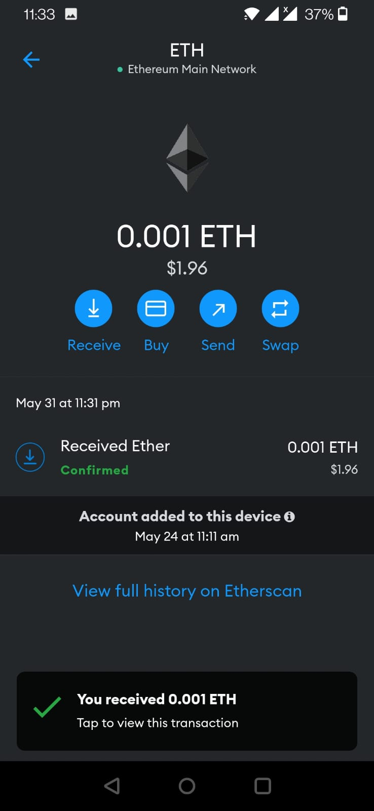
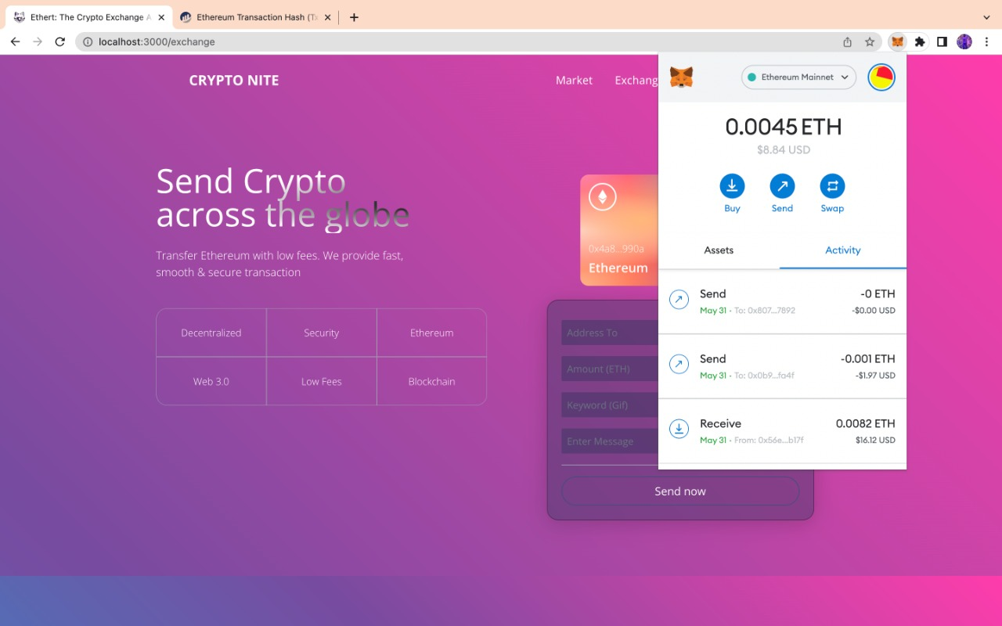
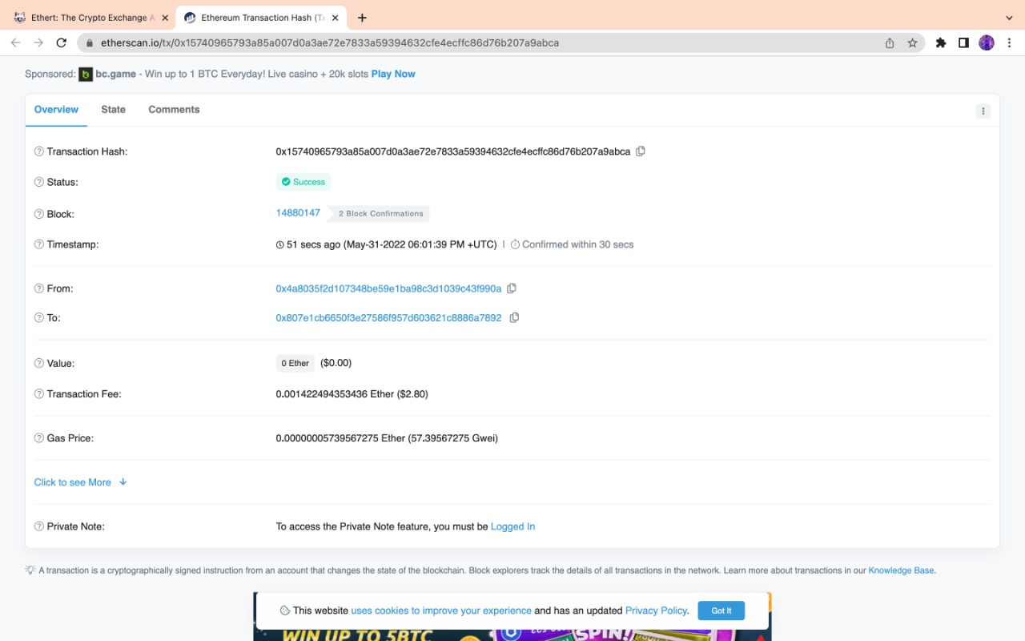
Some Snapshots of project-
Transaction Details

Slide 18
Future Work & Improvement-
Cyrpto Nite is an effective platform for trading cryptocurrencies online. It provides all over safe and sound environment for users. It is user friendly, simple to use with would definitely attract beginners. Due to surplus fake information floating on internet, many users get baffled by it and end up getting victim of it. To counter this issue, we implemented authentic pages of verified news and rates of cryptocurrencies.
There are also various dimensions in which improvement can be made for providing next level of user experience. We can also implement a section for advance or experienced users which would give them more seamless, fast and secure environment. This could be achieved by selling premium membership of our application.
We also cannot deny the fact of future implementations of blockchain technology. We are also new to Blockchain Technology, and we wish to unlock more dimensions, features and various innovative implementations of it in near future.

Slide 19
Conclusion- The end result of the mentioned methodology and planned action will be highly interactive UI which would also provide safe and secure investing environment for users. This application also provides a complete portfolio for cryptoworld. It covers all essential parts of cryptocurrency and provides user with most authentic, verified and safest data to surf, exchange, invest or withdraw among various cryptocurrencies. Also, blockchain technology implementation makes whole process encrypted and tackles all drawbacks of centralized database system, which makes this technology most promising in near future.

Slide 20
Reference & Research Article-
1. Blockchain technology, bitcoin, and Ethereum: An overview, Conference: 2018 17th International Symposium INFOTEH-JAHORINA (INFOTEH), Authors- Dejan Vujičić Dijana Jagodic Siniša Ranđić, March 2018
2. Research and Application of Smart Contract Based on Ethereum Blockchain. Journal of Physics: Conference Series. Authors- Huang, Yuxin & Wang, Ben & Wang, Yinggui, July 2021
3. Research Paper on, Research on Online Cryptocurrency Tracker Browser Extension. [ISSN No. – 2349-6002, Published by Gauri Rao, Sourabh Kumar Jha, Sadiq Hussain, Swastik Gupta. Department of Computer Engineering, Bharati Vidyapeeth College of Engineering, Pune, August 2021
4. Ethereum blockchain technology based DApp smart contract, Mathematical Biosciences and Engineering, Department of Computer Science and Engineering, Lincoln University College, Malaysia, Authors- Ch. Rupa, Divya Midhunchakkaravarthy, Mohammad Kamrul Hasan, Hesham Alhumyani and Rashid A. Saeed, August 2021.
5. Web 3.0: The Future Architecture of the Internet, 7th February 2022 Usman W. Chohan, MBA, Ph.D
6. https://reactjs.org/docs/getting-started.html
7. https://www.geeksforgeeks.org
8. https://www.blockchain.com/api
9. https://stackoverflow.com

Slide 21
THANK YOU

